Slide 1
Securing understanding of sequences
Sequences

Slide 2
how to use Oak lessons

Slide 3
I can begin to generalise a sequence.

Slide 4
A sequence is a succession of objects, diagrams or values usually formed according to a rule.

Slide 5

Securing understanding of sequences
Continuing sequences from a rule
Representations of sequences

Slide 6
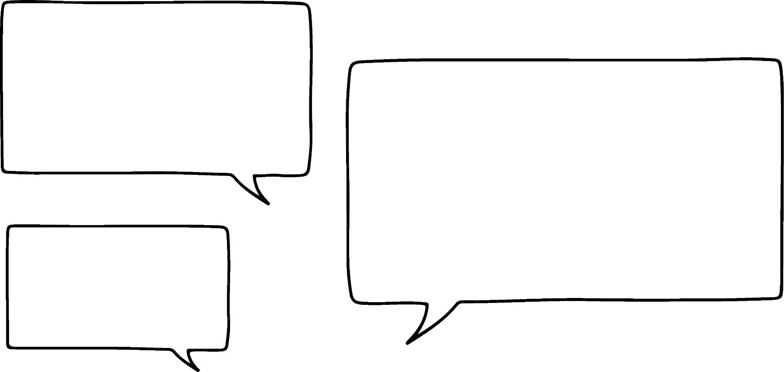



Continuing sequences from a rule
Aisha has started a sequence 2, 4, …
Aisha’s sequence could double each time
What will these sequences look like?
Laura
Aisha’s sequence could add 2 each time
Sam
Aisha’s sequence could add 2 then add 3, then add 4 …
Sofia

Slide 7
Continuing sequences from a rule
Aisha has started a sequence 2, 4, …
Aisha’s sequence could double each time
2, 4, 8, 16, 32, …
Laura
Aisha’s sequence could add 2 each time
2, 4, 6, 8, 10, …
Sam
Aisha’s sequence could add 2 then add 3, then add 4 …
2, 4, 7, 11, 16, …
Sofia

Slide 8

Continuing sequences from a rule
There are many different types of sequences. In order to continue a sequence, you can use a rule.
You can continue this sequence so it has the rule ‘plus 10’
+10
+10
+10
+10
−8
,
2
,
12
,
22
,
32
, …
You can continue this sequence so it has the rule ‘multiply by 10’
×10
×10
×10
×10
−8
,
−80
,
−800
,
−8000
,
−80 000
, …
You can continue this sequence so it has the rule ‘multiply by −0.5’
×−0.5
×−0.5
×−0.5
×−0.5
−8
,
4
,
−2
,
1
,
−0.5
, …

Slide 9

Continuing sequences from a rule
Aisha has started a new sequence with the values 10, 30, …
10
,
30
, …
The next numbers are 50 and 70
The next numbers are 90 and 270
The next numbers are 60 and 100
The next numbers are 70 and 150
Laura
Sam
Sofia
Alex
What rules might these pupils be using to get the next values in their sequences?

Slide 10
Continuing sequences from a rule
What rules might these pupils be using to get the next values in the sequence?
10
,
30
, …
The next numbers are 50 and 70
The next numbers are 90 and 270
The next numbers are 60 and 100
The next numbers are 70 and 150
Laura
Sam
Sofia
Alex
Add 20 each time.
Multiply by 3 each time
Add 10 more than previously. (add 20, then 30 then 40)
Double then add 10

Slide 11
Continuing sequences from a rule
How can you continue this sequence so that it has a constant additive rule?
+12
−2
,
10
, …
10 − (−2)= 12 so the difference between the two numbers is 12
+12
+12
+12
+12
−2
,
10
,
22
,
34
,
46
, …

Slide 12
Continuing sequences from a rule
How could we carry this sequence on so it has a constant multiplicative rule?
×(−5)
−2
,
10
, …
10 ÷ (−2) = −5 so the multiplier between the two numbers is −5
×(−5)
×(−5)
×(−5)
×(−5)
-2
,
10
,
-50
,
250
,
-1250
, …

Slide 13
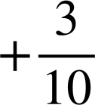




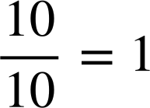
Continuing sequences from a rule
How could we carry this sequence on so it has a constant additive rule?
,
, …
,
, …
Sometimes converting to a common denominator can help:
,
,
,
, …

Slide 14


Continuing sequences from a rule
How could we carry this sequence on so it has a constant multiplicative rule?
×4
×4
,
, …
,
, …
Again converting to a common denominator can sometimes help.
×4
×4
×4
,
,
,
, …

Slide 15
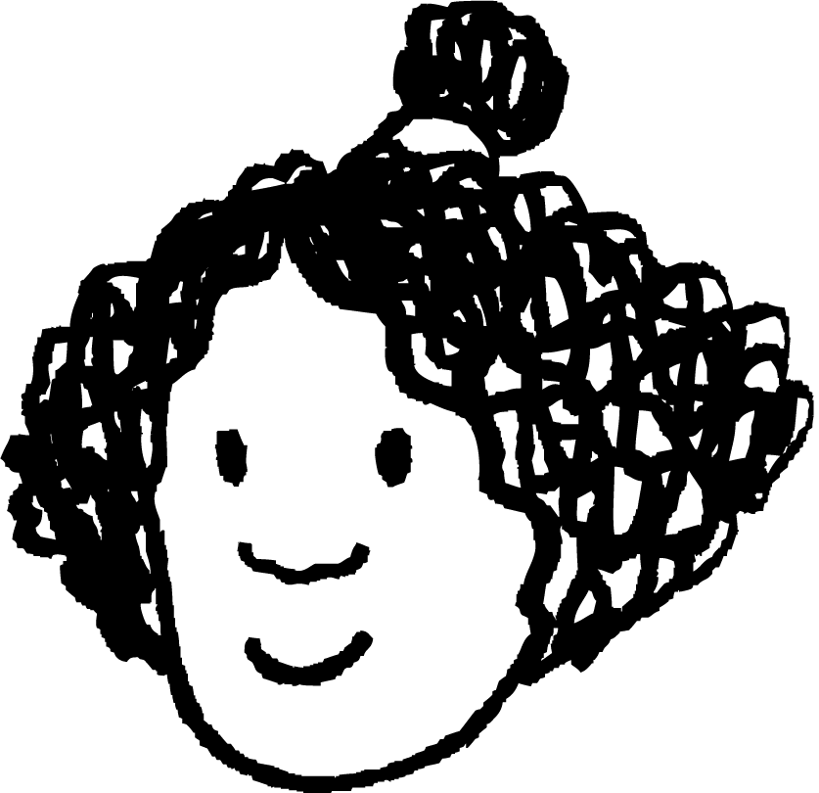
Continuing sequences from a rule
The pupils below are trying to continue the sequence −3, 9, …
Who has continued it correctly with a constant additive pattern?
Who has continued it correctly with a constant multiplicative pattern?
Sofia as the rule would be add 12
Sam as the rule would be multiply by −3
The next numbers are -12 and 36
The next numbers are -27 and 81
The next numbers are 21 and 33
The next numbers are 15 and 21
The next numbers are 27 and 81
Laura
Sam
Sofia
Alex
Izzy

Slide 16
Continuing sequences from a rule
For each two starting numbers: continue the sequence with a constant additive pattern, then a constant multiplicative pattern. Describe each of your sequences in words.
 | Additive pattern | Multiplicative pattern
a) Sequence | 1, 3, , , , … | 1, 3, , , , …
Description
b) Sequence | 0.1, 1, , , , … | 0.1, 1, , , , …
Description
c) Sequence | −16, 8, , , , … | −16, 8, , , , …
Description

Slide 17
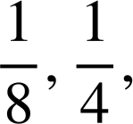
Continuing sequences from a rule
For each two starting numbers: continue the sequence with a constant additive pattern, then a constant multiplicative pattern. Describe each of your sequences in words.
 | Additive pattern | Multiplicative pattern
d) Sequence | 0.5, 1.5, , , , … | 0.5, 1.5, , , , …
Description
e) Sequence | , , , … | , , , …
Description
f) Sequence | 25, 10, , , , … | 25, 10, , , , …
Description

Slide 18

Continuing sequences from a rule
For each two starting numbers: continue the sequence with a constant additive pattern, then a constant multiplicative pattern. Describe each of your sequences in words.
 | Additive pattern | Multiplicative pattern
a) Sequence | 1, 3, 5, 7, 9, … | 1, 3, 9, 27, 81 …
Description | Start on 1 then add 2 each time | Start on 1 then multiply by 3 each time
b) Sequence | 0.1, 1, 1.9, 2.8, 3.7, … | 0.1, 1, 10, 100, 1000, …
Description | Start on 0.1 then add 0.9 each time | Start on 0.1 then multiply by 10 each time
c) Sequence | −16, 8, 32, 56, 80, … | −16, 8, −4, 2, −1, …
Description | Start on (−16) then add 24 each time | Start on −16 then multiply by

Slide 19
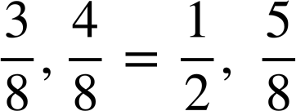
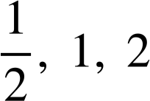

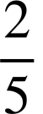
Continuing sequences from a rule
 | Additive pattern | Multiplicative pattern
d) Sequence | 0.5, 1.5, 2.5, 3.5, 4.5, … | 0.5, 1.5, 4.5, 13.5, 40.5, …
Description | Start on 0.5 then add 1 | Start on 0.5 then multiply by 3
e) Sequence | … | …
Description | Start on and add | Start on and multiply by 2
f) Sequence | 25, 10, −5, −20, −35, … | 25, 10, 4, , , … (25, 10, 4, 1.6, 0.64, …)
Description | Start on 25 then subtract 15 | Start at 25 then multiply by

Slide 20
Securing understanding of sequences
Continuing sequences from a rule
Representations of sequences

Slide 21
Representations of sequences
Izzy is building sequences with cuisenaire rods. Each tower is a value in the sequence. What could the rule be for her sequence?
This is an additive sequence with the same value being added each time
Eg. add 2

Slide 22
Representations of sequences
Which sequence has the same additive pattern as Izzy’s sequence?
This sequence looks to be doubling each time
This sequence is adding the larger (purple) rod each time
This sequence is adding the larger (green) rod each time
This sequence also adds one red rod each time

Slide 23
Representations of sequences
What is the same and what is different in these sequences?
They all start on the same value and have a constant additive pattern.
The value that is added on each time differs between the sequences.

Slide 24
Representations of sequences
What is the same and what is different in these sequences?
They all have a constant additive pattern. Each sequence adds a green rod each time.
The value that the sequence starts on changes.

Slide 25
Representations of sequences
Here is Izzy’s original sequence.
Is this the same sequence?
No it has the same constant additive rule but starts on a different value.

Slide 26
Representations of sequences
Here is Izzy’s original sequence.
Is this the same sequence?
No, it has some of the same values in it and it increases by the same amount but Izzy’s sequence starts on a different value.

Slide 27
Representations of sequences
Here is Izzy’s original sequence.
Is this the same sequence?
Yes the sequences are both made up of the same values in the same order, the sequence starts on one purple rod and adds one red rod each time.

Slide 28
Representations of sequences
What is the same and what is different in these sequences?
They both start on the same value.
The first one is adding one red rod each time.
The second one is adding one purple rod each time.

Slide 29


Representations of sequences
Each diagram shows a sequence of three objects.
Match the diagram with the rule that could have been used to create it.
Add 1 each time
Add 2 each time
Add 4 each time
Multiply by 2 each time

Slide 30
Representations of sequences
Izzy has built these patterns using blocks. Which two patterns could she combine to make a sequence which
Increases by 5 each time
Increases by 2 each time
Decreases by 1 each time
A
B
C
D

Slide 31
Representations of sequences
4) Laura and Andeep are making a repeating pattern from different shaped counters
1
2
3
4
5
6
7
8
9
10
11
12
…
What shape counter will the number 25 be?
Laura puts down the counters 144, 145 and 146, what shapes are they?
Andeep puts down three counters in a row which are all oval shapes. They are all greater than 50 but less than 60, what numbers could they be?
Laura and Andeep run out of counters when they put down the counter 178. How many of each type did they use in total?

Slide 32
Representations of sequences
Izzy has built these patterns using blocks. Which two patterns could she combine to make a sequence which
Increases by 5 each time
A and D
+
=
2) Increases by 2 each time
B and D
+
=

Slide 33
Representations of sequences
Izzy has built these patterns using blocks. Which two patterns could she combine to make a sequence which
3) Decreases by 1 each time
A and B
+
=

Slide 34
Representations of sequences
4) Laura and Andeep are making a repeating pattern from different shaped counters
1
2
3
4
5
6
7
8
9
10
11
12
…
What shape counter will the number 25 be?
Square as all multiples of 5 are squares
Laura puts down the counters 144, 145 and 146, what shapes are they?
Oval, square, triangle as squares are multiples of 5 so 145 must be square

Slide 35
Representations of sequences
4) Laura and Andeep are making a repeating pattern from different shaped counters
1
2
3
4
5
6
7
8
9
10
11
12
…
Andeep puts down three counters in a row which are all oval shapes. They are all greater than 50 but less than 60, what numbers could they be?
52, 53, 54 or 57, 58, 59.
Laura and Andeep run out of counters when they put down the counter 178. How many of each type did they use in total?
= 35 =107 =36

Slide 36
Securing understanding of sequences
If we know a rule for a sequence we can continue a sequence from a starting value.
It is possible to describe a sequence in words if we know enough values.
There can be more than one rule linking two successive numbers in a sequence.
Rules can be demonstrated with diagrams, this can help us see how a pattern is developing.

Slide 37

© Oak National Academy 2023.
Produced in partnership with Mathematics in Education and Industry.
Licensed on the Open Government Licence v3.0, except where otherwise stated. See Oak terms and conditions.

